Slide 1
Quick start
Shuhao Wu

Slide 2
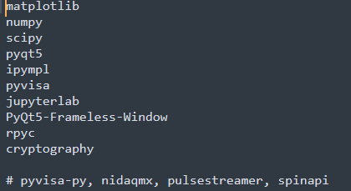
1, Read documentation of device, logic, live_plot, GUI
Device -> logic -> live_plot -> GUI
2, run setup_env.bat to install all required python packages, if it fails you can also install manually, refer to requirements.txt.
Pyvisa-py, nidaqmx, pulsestreamer, spinapi etc. are also recommend to install
3, run ‘jupyter notebook examples’/run_jupyterlab.bat to start jupyterlab
4, run example_quick_start.ipynb to get yourself familiar with the basic operations
5, configure your own devices/pulse/experiment, and run measurement

